Slide 1

열정을 가진 자들이 모여 세상을 개척한다
심화반 Week 4.
DL-Basic (CNN 이론 & CNN Architecture)
Presenter: Daehyun Kim
GDG Campus Korea
MODULABS AI/SW Lab.

Slide 2
01
Convolution Neural Net 이론

Slide 3
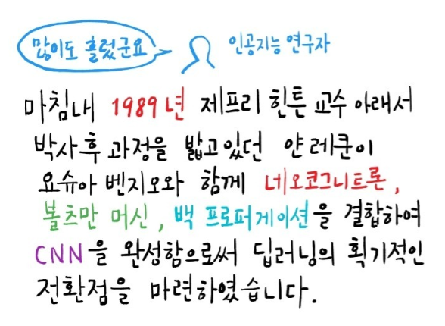
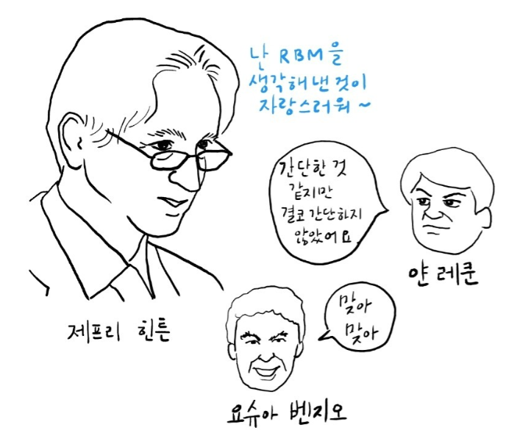
PNP
PASSSION & PIONEER
CNN
CNN 탄생 배경
Y. Lecun, L. Bottou, Y. Bengio, P. Haffner, “Gradient-based learning applied to document recognition”

Slide 4
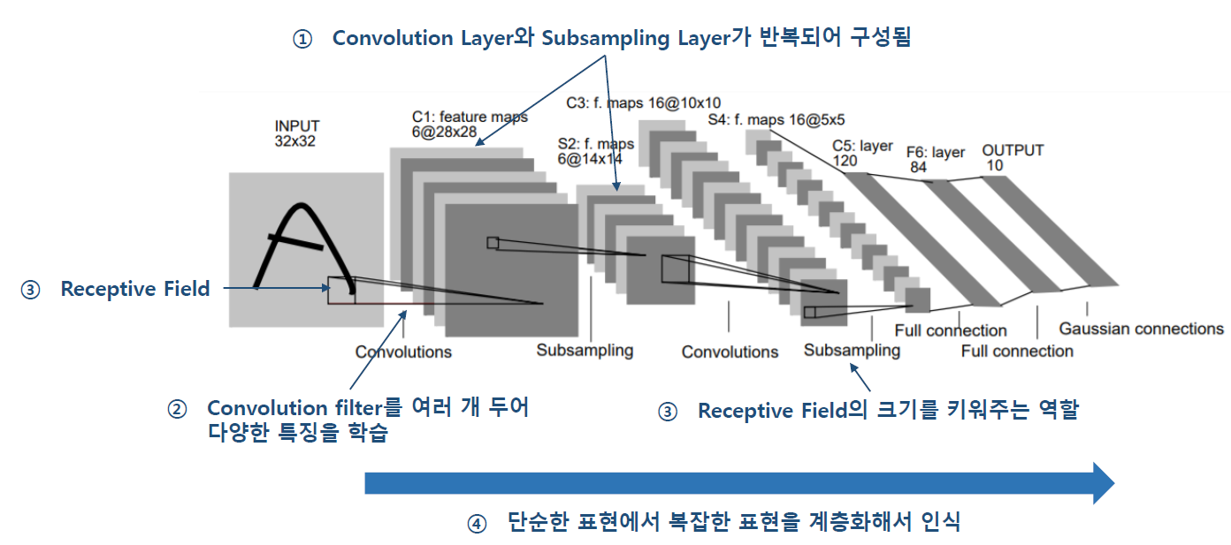
PNP
PASSSION & PIONEER
CNN
Convolutional Neural Network (1998)
이미지와 같은 공간적인 특징을 가지는 고차원 데이터 처리를 위한 Neural Net
각 필터가 가중치를 가지며 Filter 단위로 파라미터를 공유하는 특징이 있다.
Y. Lecun, L. Bottou, Y. Bengio, P. Haffner, “Gradient-based learning applied to document recognition”

Slide 5
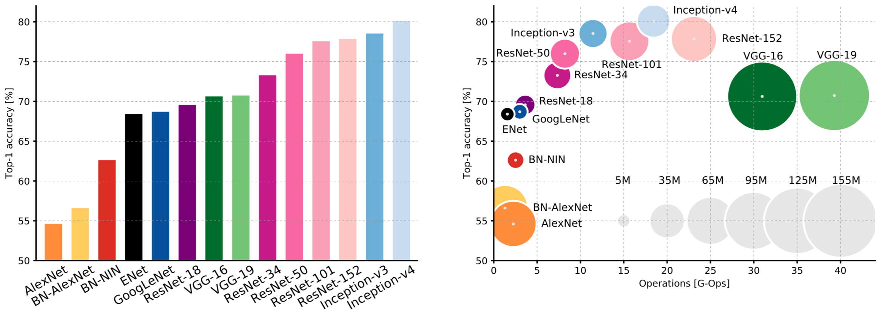
PNP
PASSSION & PIONEER
CNN
CNN Architecture
ImageNet challenge를 반복하며 다양한 모델들이 개발되었다.
Y. Lecun, L. Bottou, Y. Bengio, P. Haffner, “Gradient-based learning applied to document recognition”

Slide 6
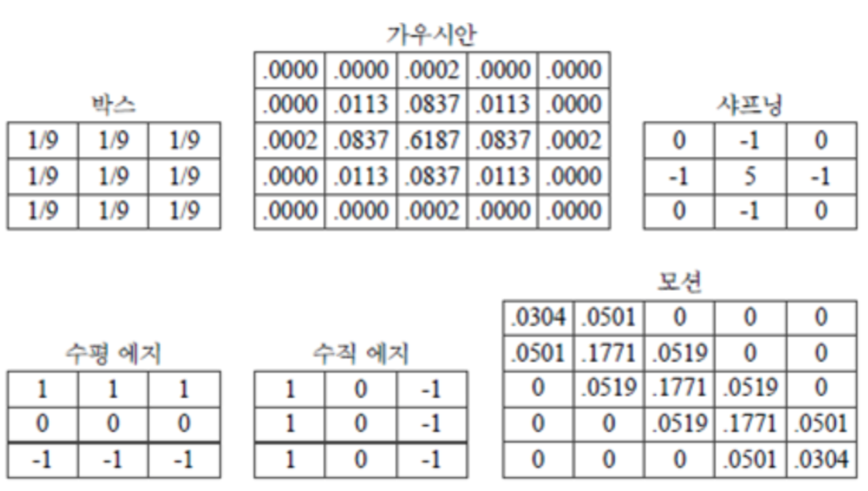
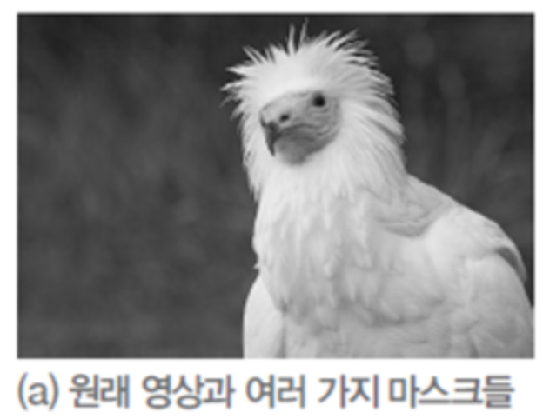
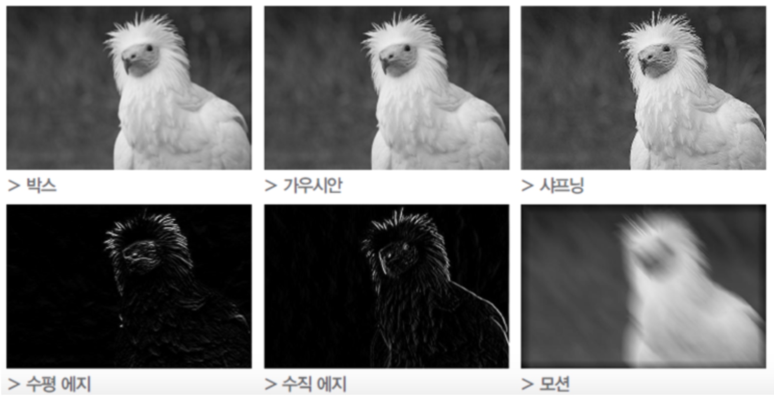
PNP
PASSSION & PIONEER
CNN
Convolution
이미지에 필터를 이동시키며
연산해 결과를 얻는 연산 방법
Y. Lecun, L. Bottou, Y. Bengio, P. Haffner, “Gradient-based learning applied to document recognition”

Slide 7
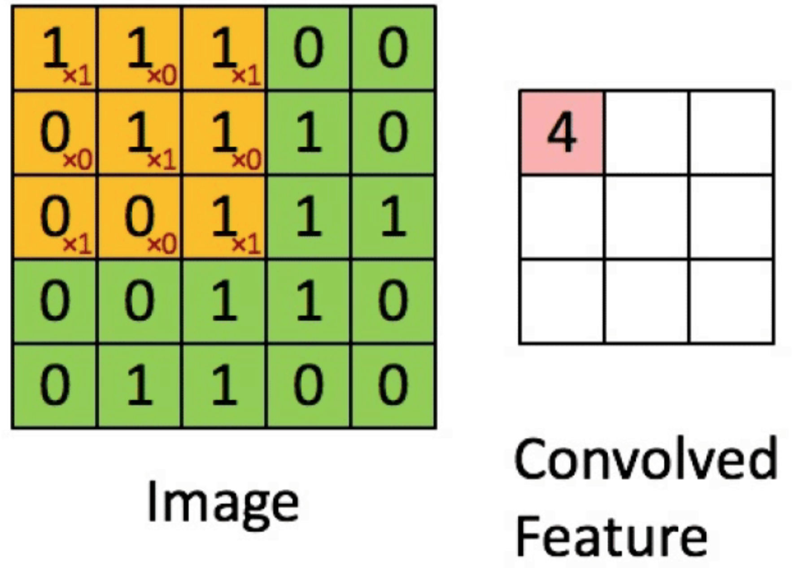
PNP
PASSSION & PIONEER
CNN
Convolution 연산
각 필더가 가중치를 가지며, 입력된 데이터와 연산된다. -> 보통 ReLU 사용
(1이 해당하는 값이 나오면 해당위치에서 입력값이 양수, 즉 활성화 되었다.)
Y. Lecun, L. Bottou, Y. Bengio, P. Haffner, “Gradient-based learning applied to document recognition”

Slide 8
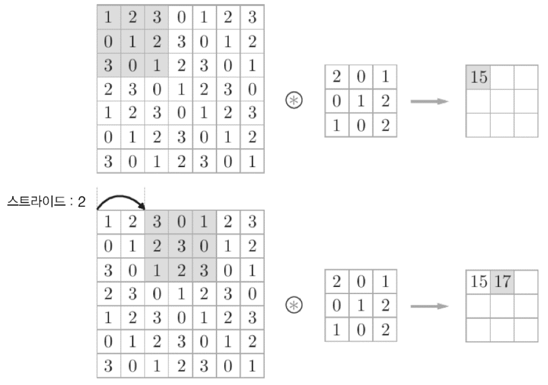
PNP
PASSSION & PIONEER
CNN
Convolution with stride
stride의 크기에 따라 필터가 이동하는 크기가 정해진다.
filter size, stride의 크기에 따라 output size가 달라진다.

Slide 9
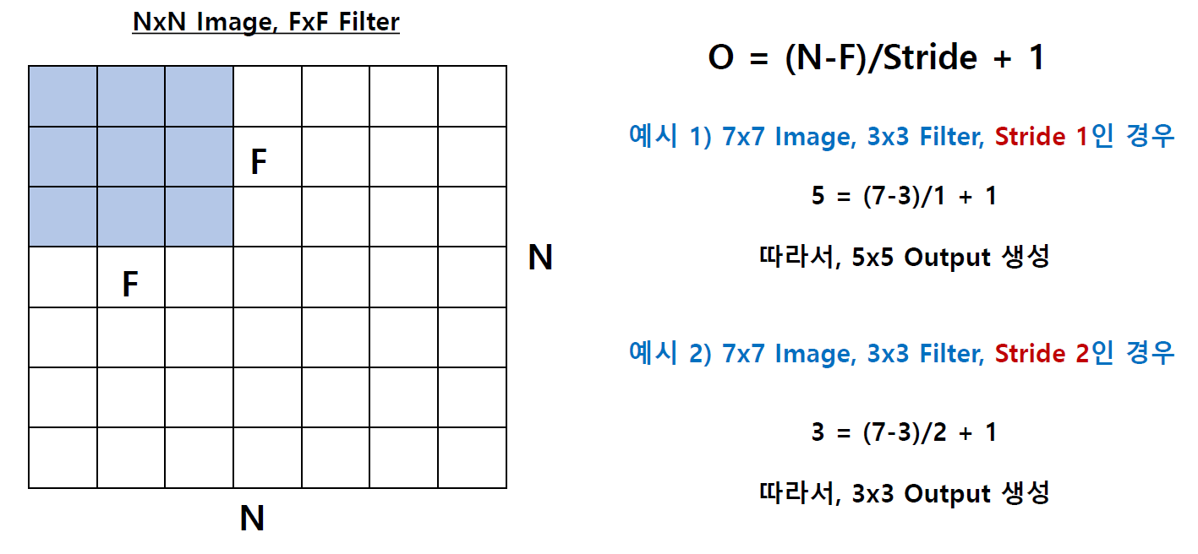
PNP
PASSSION & PIONEER
CNN
Convolution with stride

Slide 10
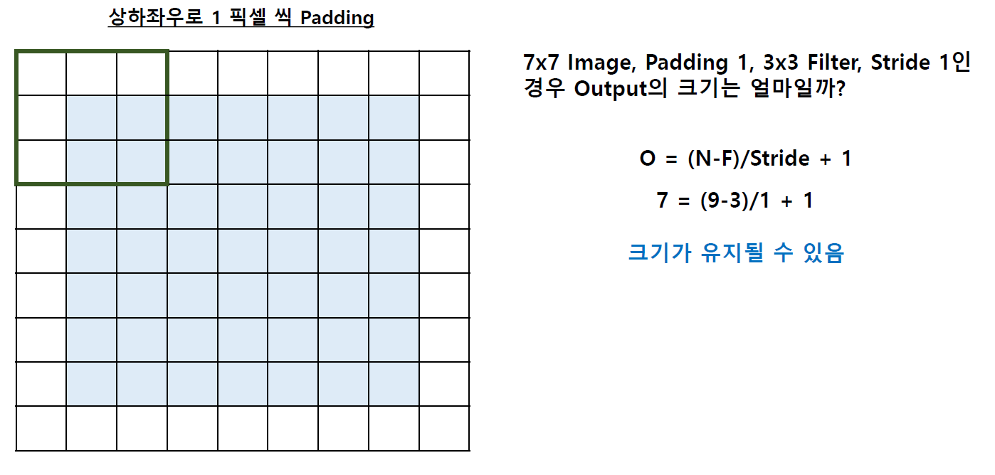
PNP
PASSSION & PIONEER
CNN
Convolution with padding

Slide 11
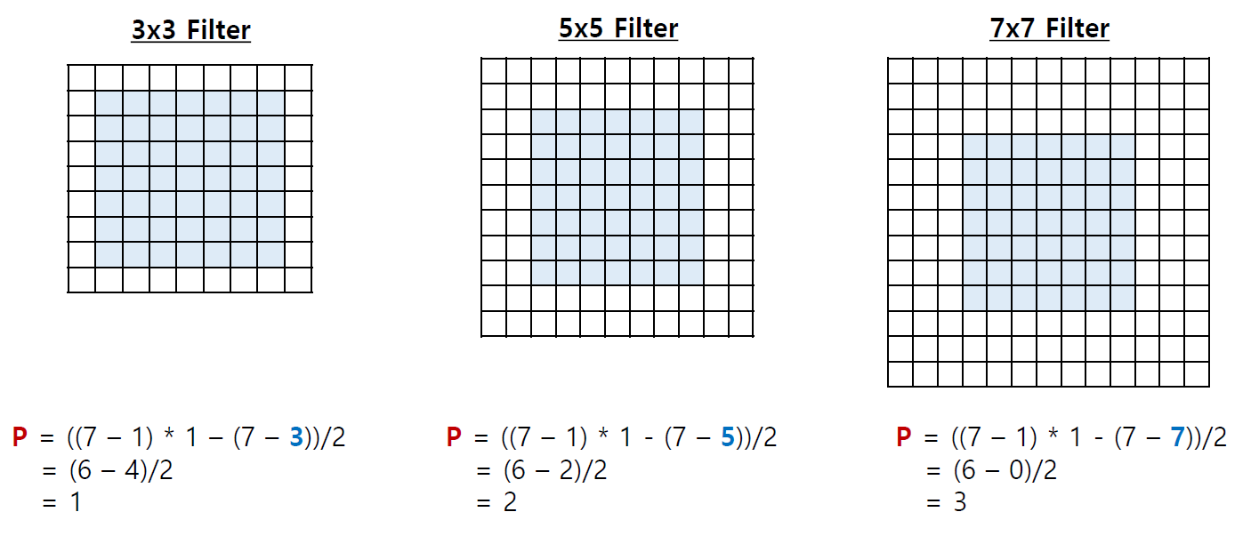
PNP
PASSSION & PIONEER
CNN
Convolution with padding
7x7 image, stride=1 일때 Same size를 위한 padding

Slide 12
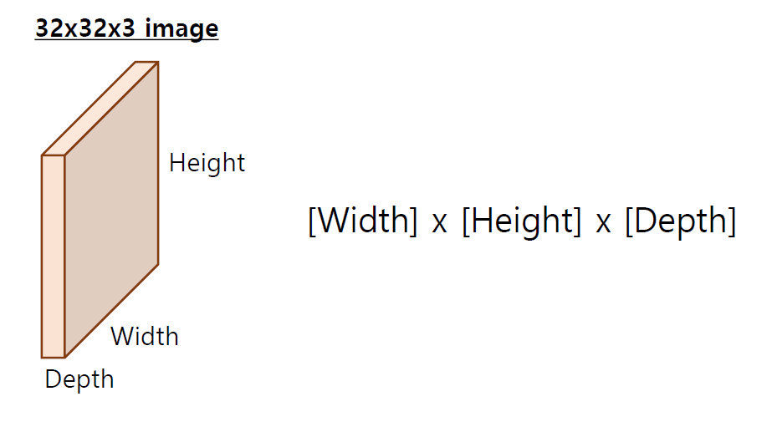
PNP
PASSSION & PIONEER
CNN
Convolution 연산
Y. Lecun, L. Bottou, Y. Bengio, P. Haffner, “Gradient-based learning applied to document recognition”

Slide 13
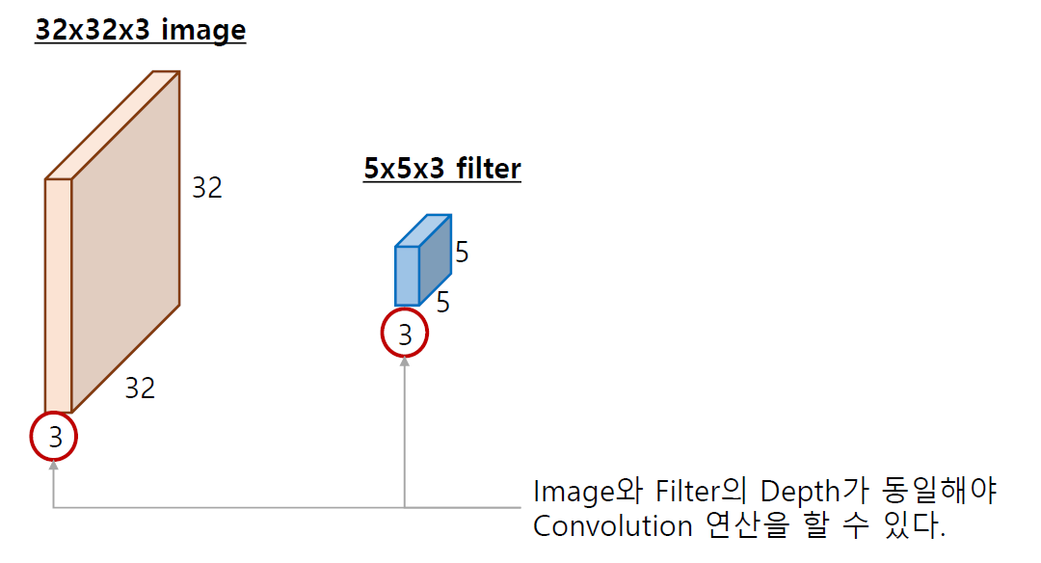
PNP
PASSSION & PIONEER
CNN
Convolution 연산
Y. Lecun, L. Bottou, Y. Bengio, P. Haffner, “Gradient-based learning applied to document recognition”

Slide 14
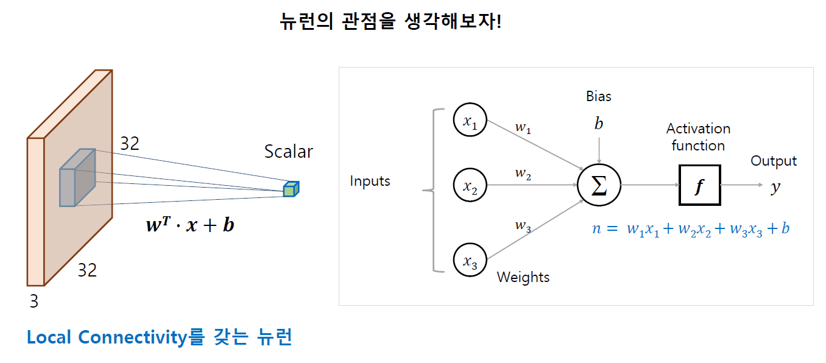
PNP
PASSSION & PIONEER
CNN
Convolution 연산
Y. Lecun, L. Bottou, Y. Bengio, P. Haffner, “Gradient-based learning applied to document recognition”

Slide 15
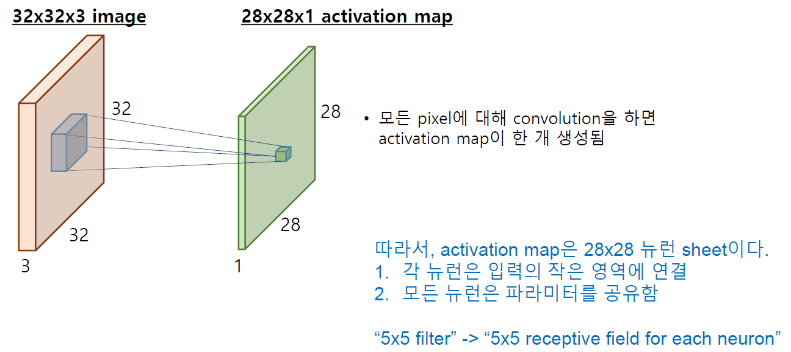
PNP
PASSSION & PIONEER
CNN
Convolution 연산
Y. Lecun, L. Bottou, Y. Bengio, P. Haffner, “Gradient-based learning applied to document recognition”

Slide 16
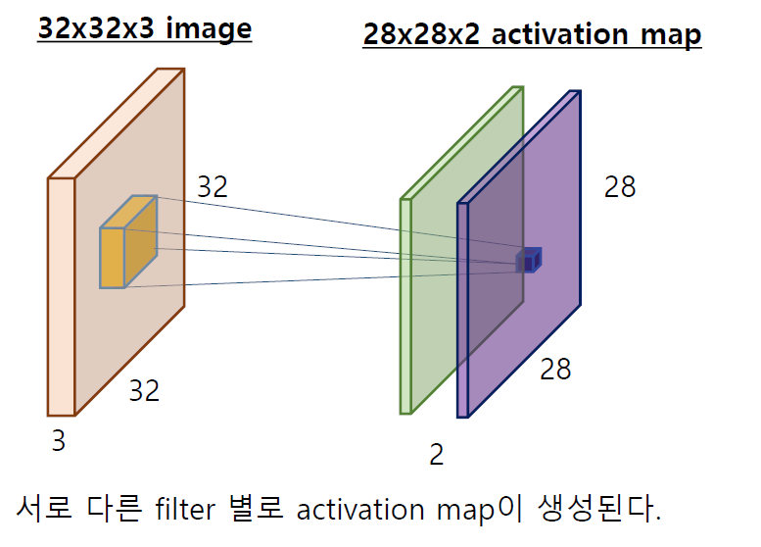
PNP
PASSSION & PIONEER
CNN
Convolution 연산
Y. Lecun, L. Bottou, Y. Bengio, P. Haffner, “Gradient-based learning applied to document recognition”

Slide 17
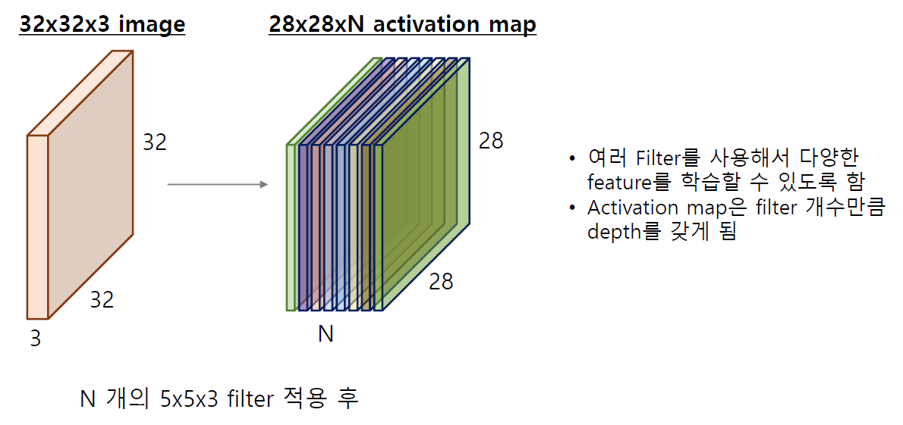
PNP
PASSSION & PIONEER
CNN
Convolution 연산
Y. Lecun, L. Bottou, Y. Bengio, P. Haffner, “Gradient-based learning applied to document recognition”

Slide 18
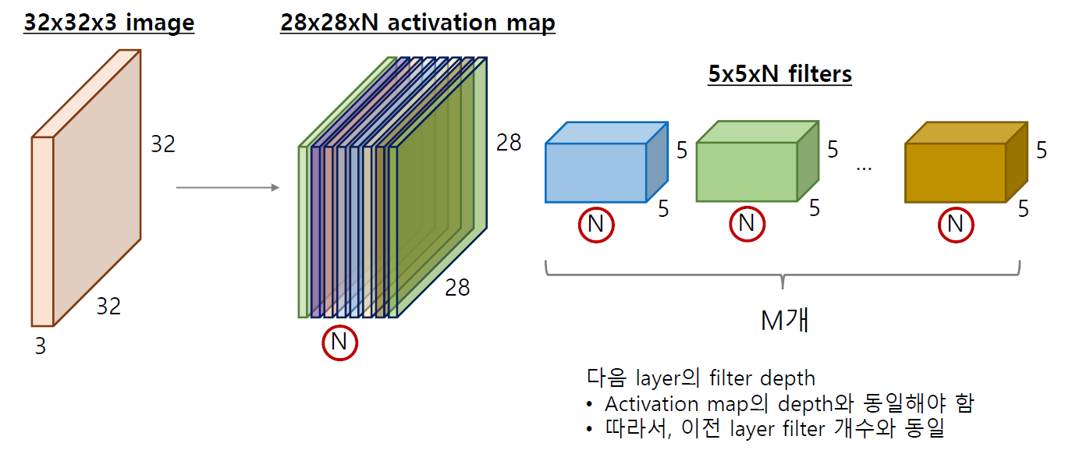
PNP
PASSSION & PIONEER
CNN
Convolution 연산
Y. Lecun, L. Bottou, Y. Bengio, P. Haffner, “Gradient-based learning applied to document recognition”

Slide 19
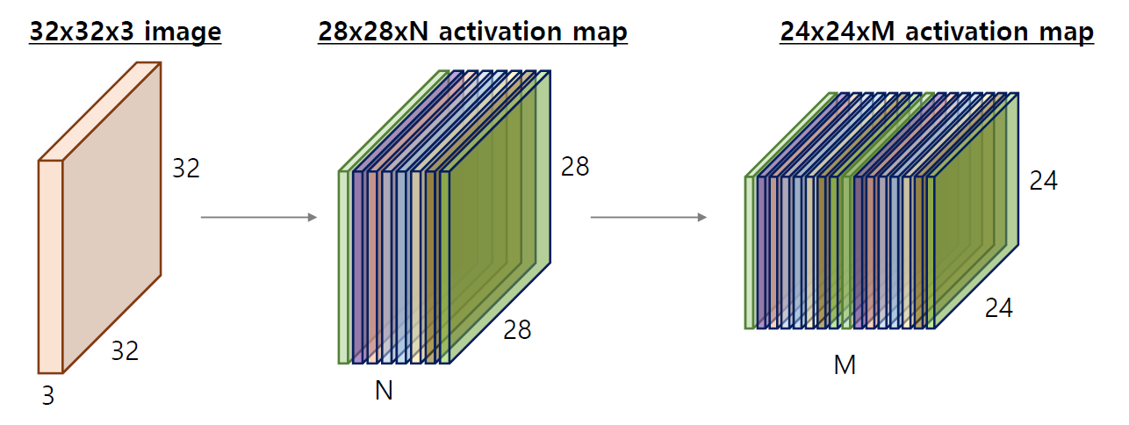
PNP
PASSSION & PIONEER
CNN
Convolution 연산
Y. Lecun, L. Bottou, Y. Bengio, P. Haffner, “Gradient-based learning applied to document recognition”

Slide 20
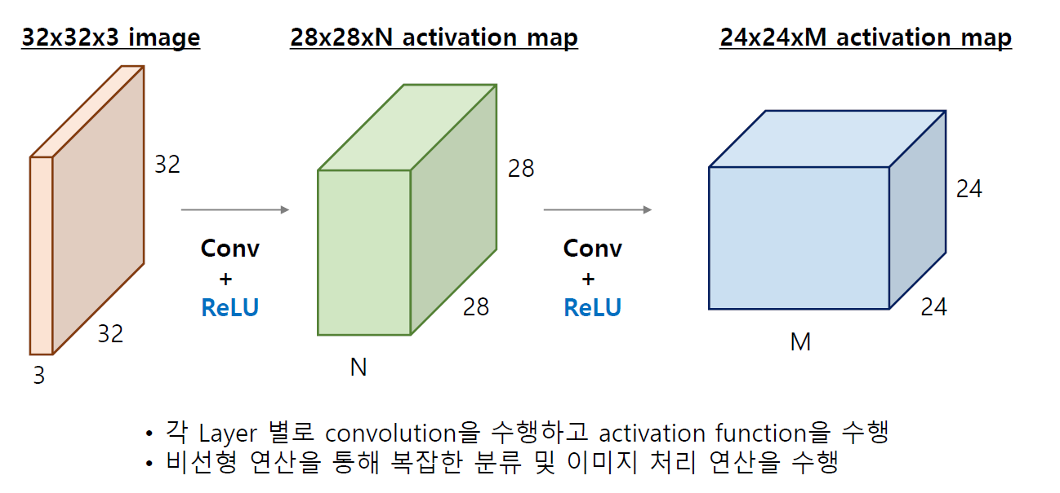
PNP
PASSSION & PIONEER
CNN
Convolution 연산
Y. Lecun, L. Bottou, Y. Bengio, P. Haffner, “Gradient-based learning applied to document recognition”

Slide 21
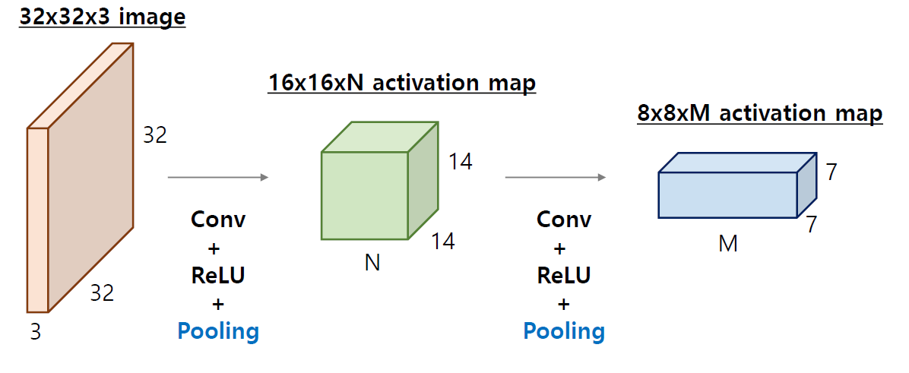
PNP
PASSSION & PIONEER
CNN
Convolution 연산
Pooling을 통해 size를 줄이며 중요한 데이터를 더 적은 파라미터로 확인한다.
이유는? 입력 이미지의 주요한 특징만 추출, 계산량 감소, Overfitting 방지 목적
Y. Lecun, L. Bottou, Y. Bengio, P. Haffner, “Gradient-based learning applied to document recognition”

Slide 22
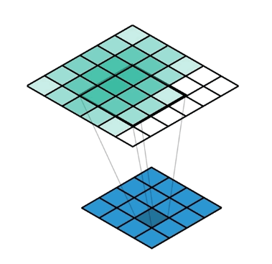
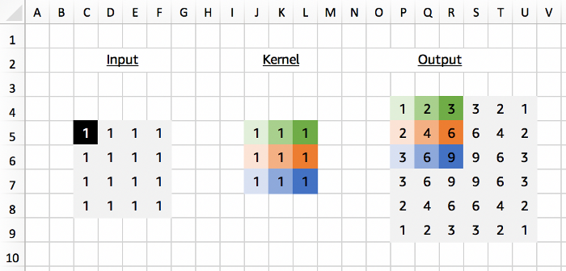
PNP
PASSSION & PIONEER
CNN
Convolution NN Transpose
Convolution의 역연산으로 Upsampling을 진행
쉽게 말하면 Convolution으로 img size를 줄였던것을 다시 사이즈를 키운다.
주어진 이미지의 한 픽셀을 생성된 Conv Transpose filter를 이용해 Upsampling
이미지를 잘라냄
https://medium.com/apache-mxnet/transposed-convolutions-explained-with-ms-excel-52d13030c7e8

Slide 23
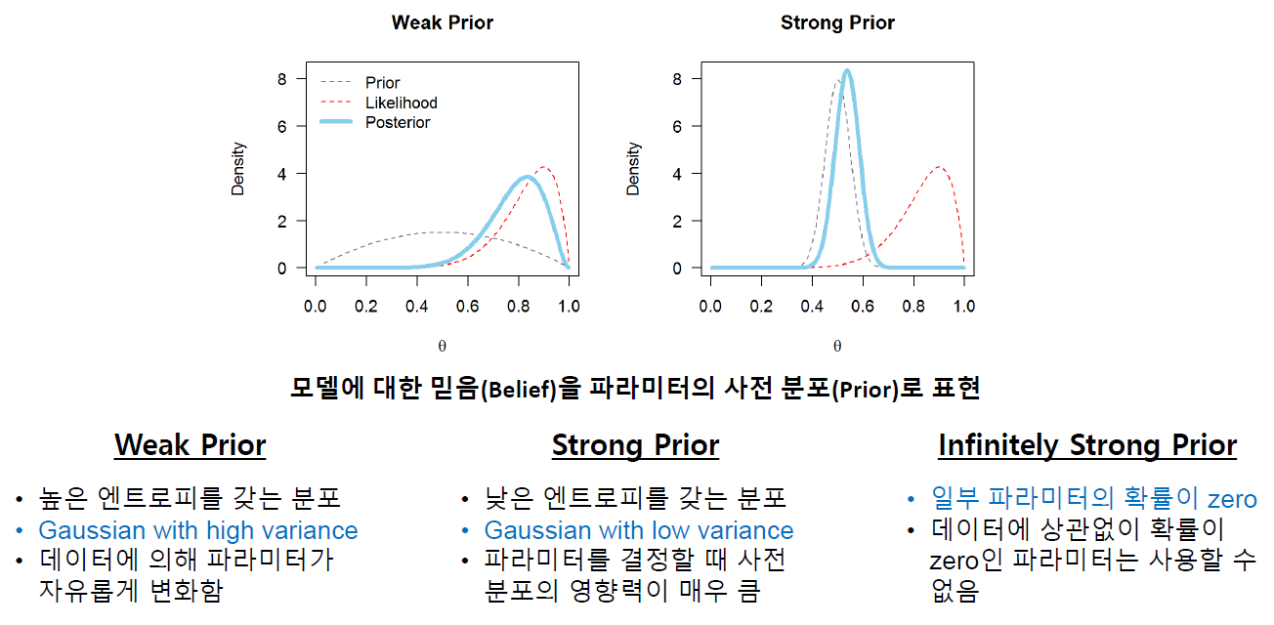
PNP
PASSSION & PIONEER
CNN
CNN 가정사항

Slide 24
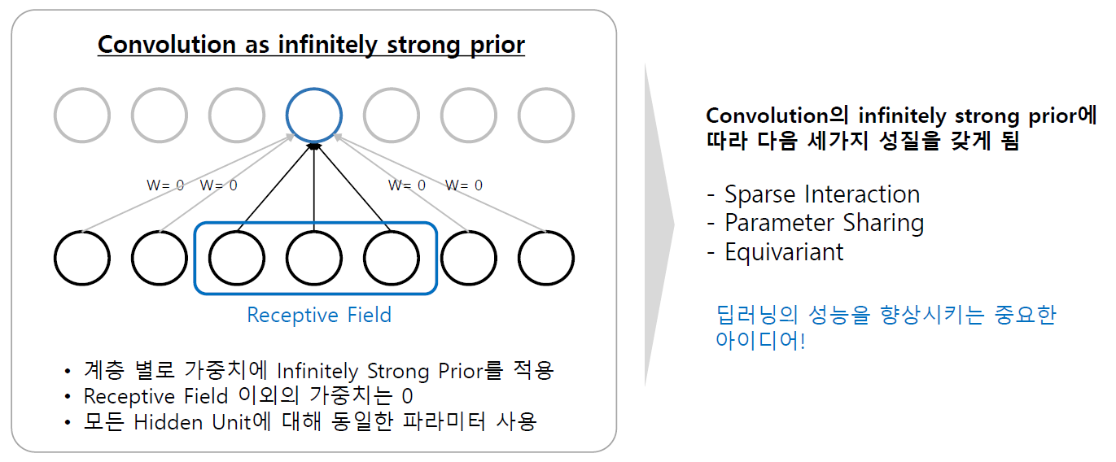
PNP
PASSSION & PIONEER
CNN
CNN as infinitely strong prior
CNN이 이미지 처리 작업에 대한 사전 지식(정보)을 무한히 강력하게 가지고 있다.
여기서 사전 지식(정보)는 모델이 데이터를 학습하기 전에 이미 알고 있는 정보를 의미.

Slide 25
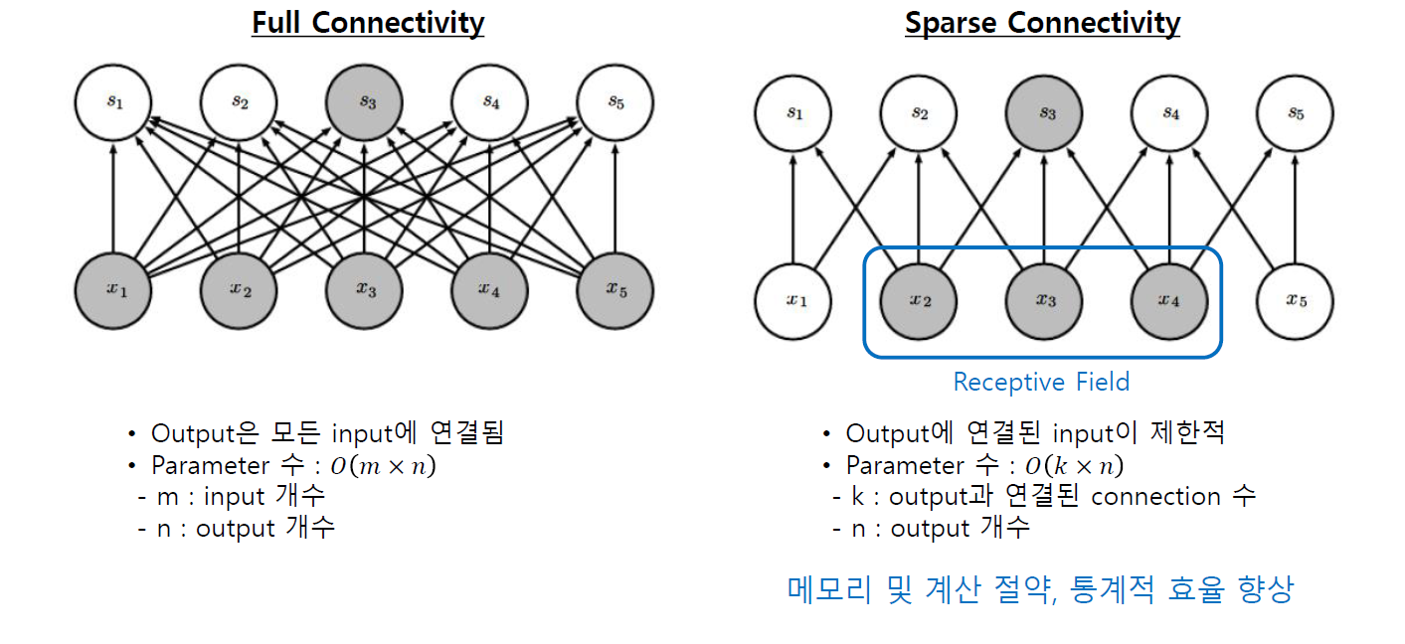
PNP
PASSSION & PIONEER
CNN
Sparse Interaction
변수간의 상호작용이 희소하게 발생하는 경우를 나타냄.
Weight Value (가중치 값)이 안변함, Sparse Interaction 고려하면 과적합 방지, 일반화 성능 향상
Filter 안에서 볼수있는 범위가 제한적.
더 작은
Parameter도
계산 가능

Slide 26
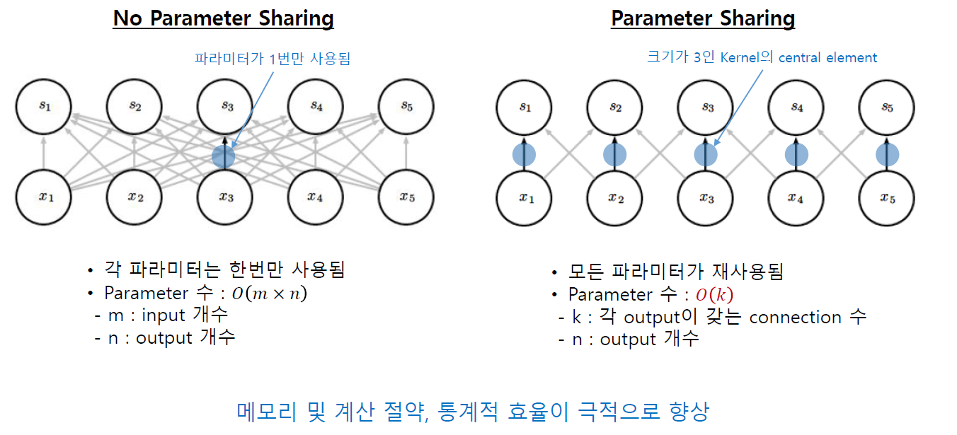
PNP
PASSSION & PIONEER
CNN
Parameter Sharing

Slide 27
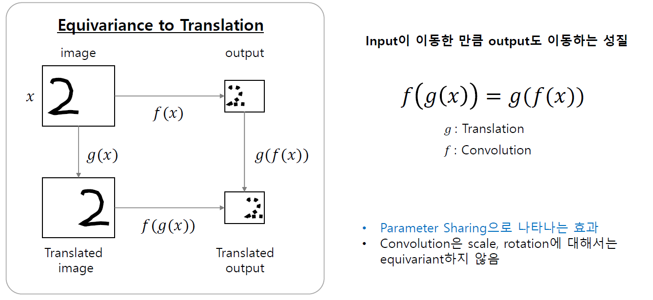
PNP
PASSSION & PIONEER
CNN
Equivariance – 이동 불변성
입력 데이터에 대한 변환 (이동)이 모델에 출력에 동일한 변환을 일으킨다.
같은 특징을 가진 애들이 이동해도 찾음
이 현상들은 augmentation에서 보완.
- 기존의 학습 데이터를 변형하여 새로운 학습 데이터를 생성하는 과정

Slide 28
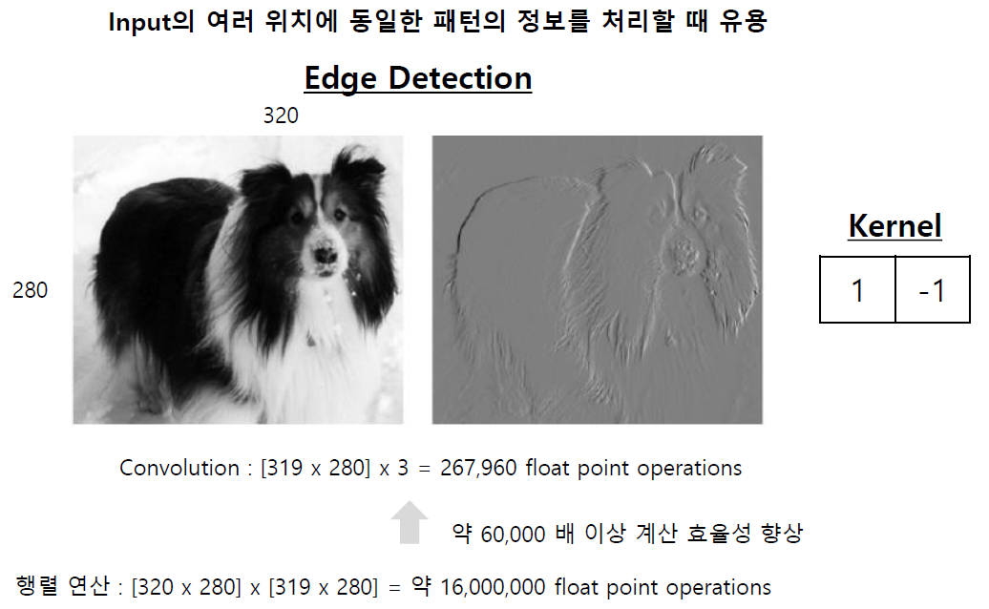
PNP
PASSSION & PIONEER
CNN
Parameter Sharing

Slide 29
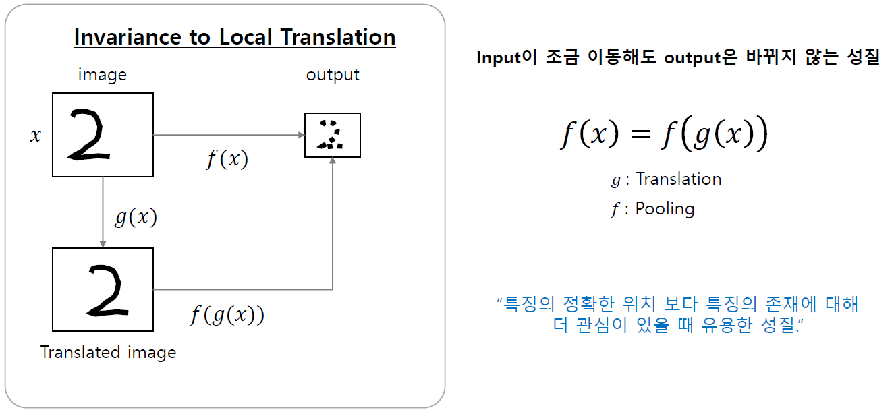
PNP
PASSSION & PIONEER
CNN
Invariance to Local Translation

Slide 30
02
CNN Architecture

Slide 31
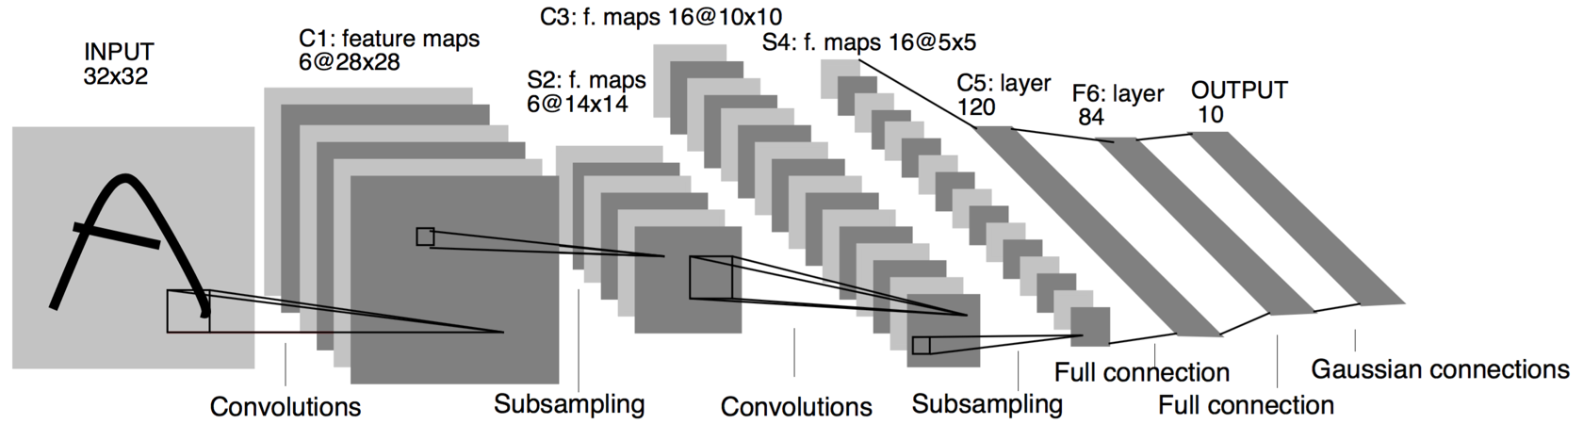
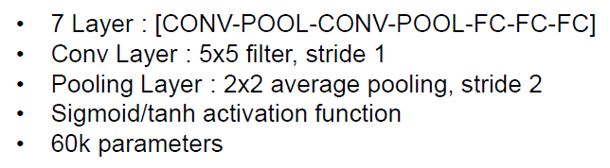
PNP
PASSSION & PIONEER
CNN Architecture
CNN Architecture - LeNet 5

Slide 32
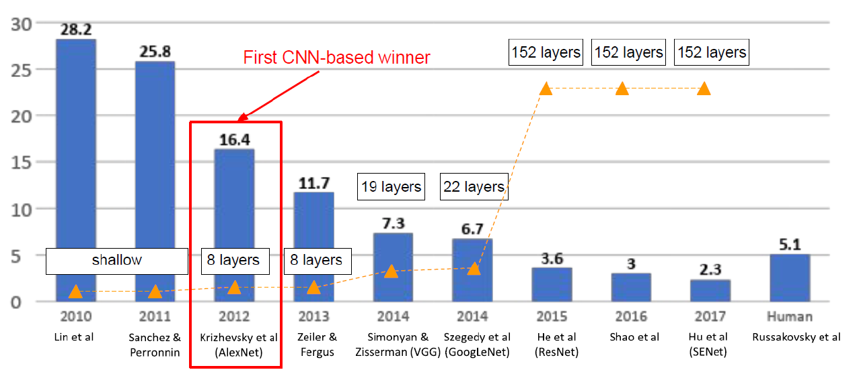
PNP
PASSSION & PIONEER
CNN Architecture
CNN Architecture - AlexNet
ImageNet ILSVRC(Large Scale Visual Recognition Challenge) winners

Slide 33
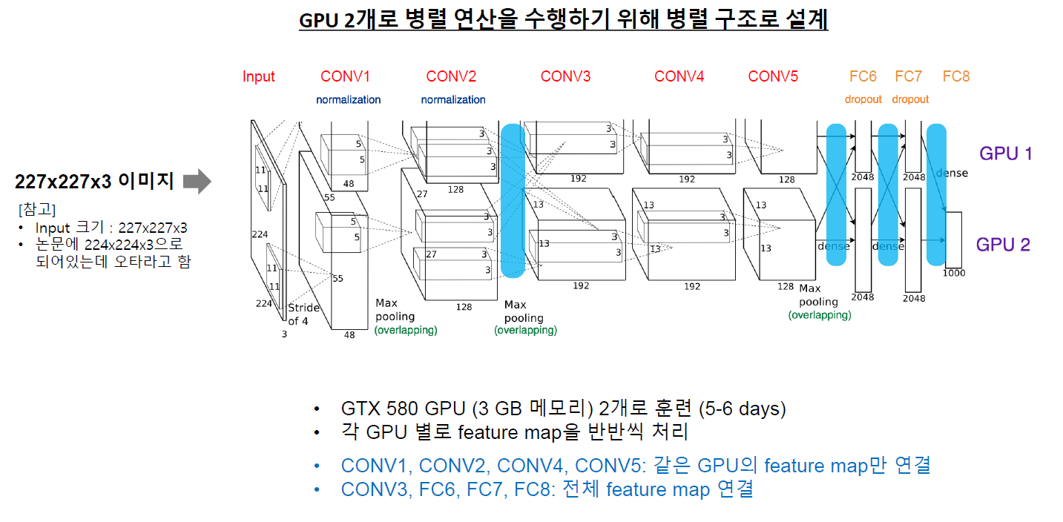
PNP
PASSSION & PIONEER
CNN Architecture
CNN Architecture - AlexNet

Slide 34
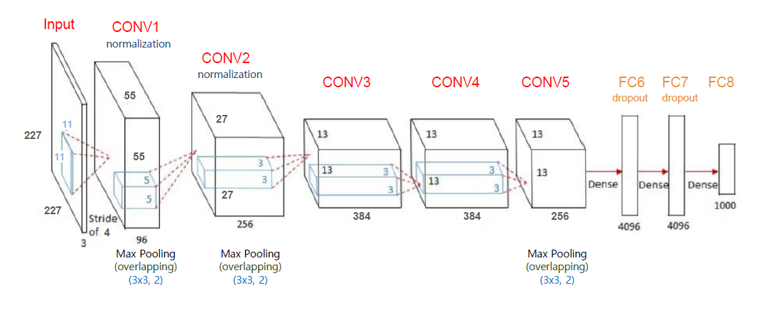
PNP
PASSSION & PIONEER
CNN Architecture
CNN Architecture - AlexNet
아래 네트워크를 쪼개서 GPU로 병렬처리

Slide 35
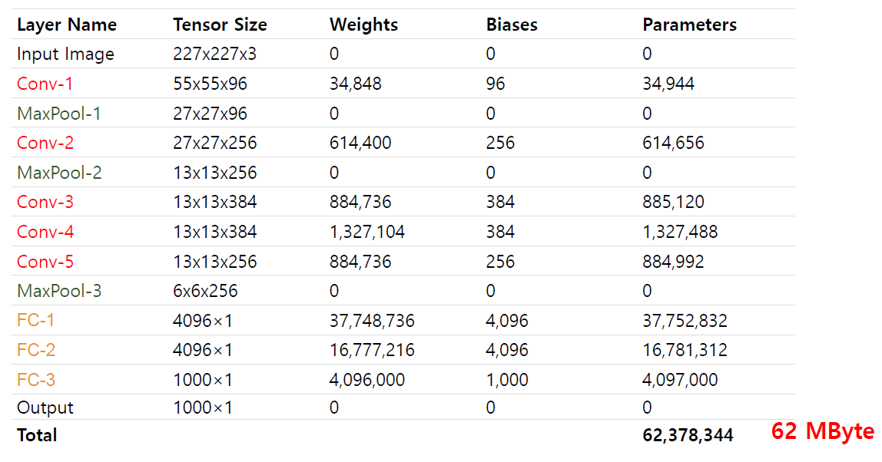
PNP
PASSSION & PIONEER
CNN Architecture
CNN Architecture - AlexNet
https://www.learnopencv.com/number-of-parameters-and-tensor-sizes-in-convolutional-neural-network/

Slide 36
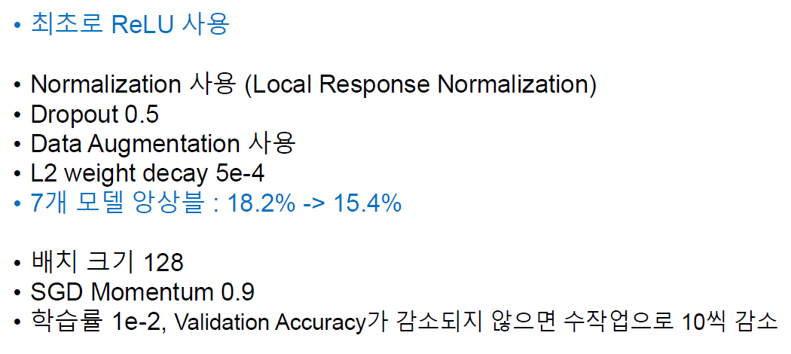
PNP
PASSSION & PIONEER
CNN Architecture
CNN Architecture - AlexNet
https://www.learnopencv.com/number-of-parameters-and-tensor-sizes-in-convolutional-neural-network/

Slide 37
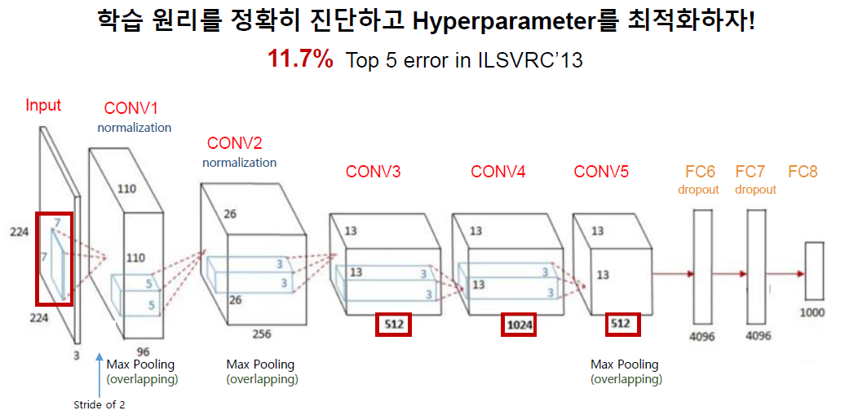
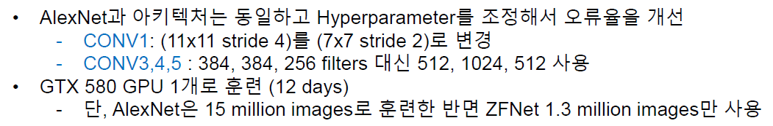
PNP
PASSSION & PIONEER
CNN Architecture
CNN Architecture - ZFNet

Slide 38
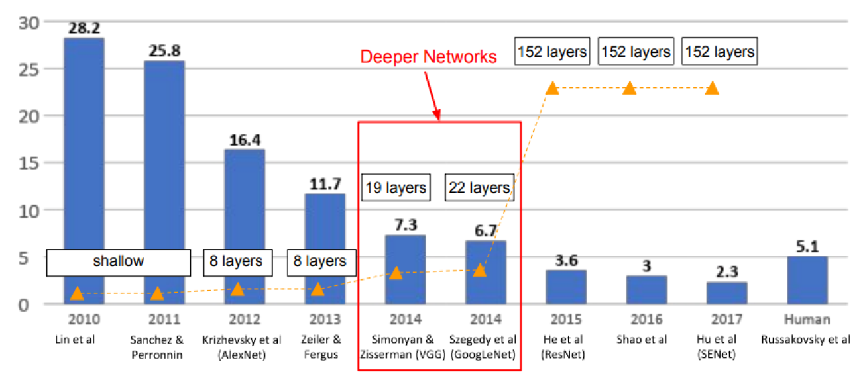
PNP
PASSSION & PIONEER
CNN Architecture
CNN Architecture - VGGNet
ImageNet ILSVRC(Large Scale Visual Recognition Challenge) winners

Slide 39
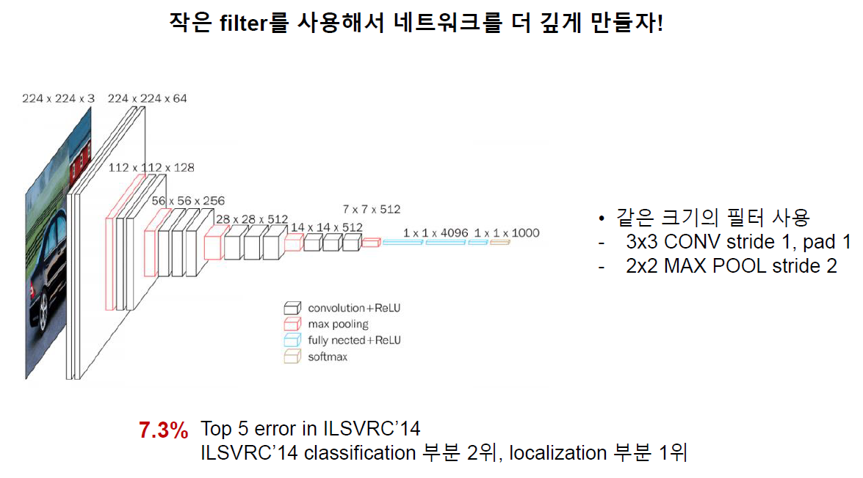
PNP
PASSSION & PIONEER
CNN Architecture
CNN Architecture - VGGNet
“Very Deep Convolutional Networks for Large-Scale Image Recognition”

Slide 40
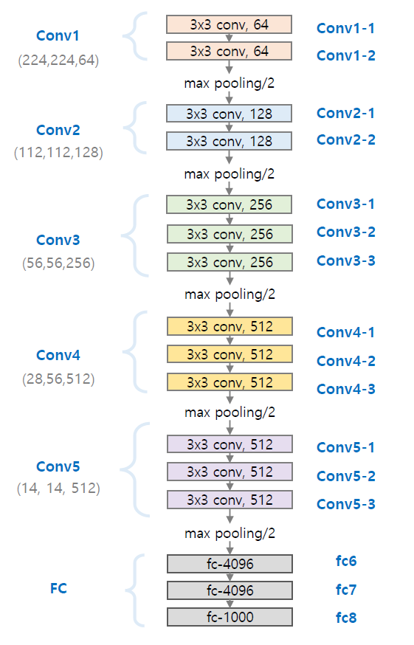
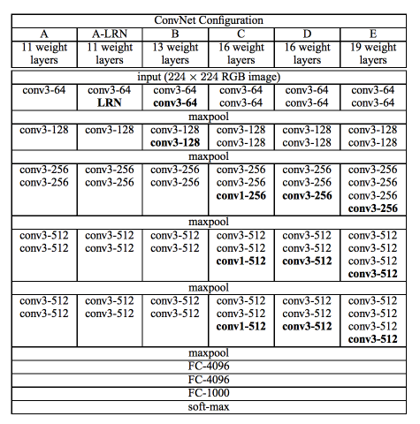
PNP
PASSSION & PIONEER
CNN Architecture
CNN Architecture - VGGNet
VGG16
“Very Deep Convolutional Networks for Large-Scale Image Recognition”

Slide 41
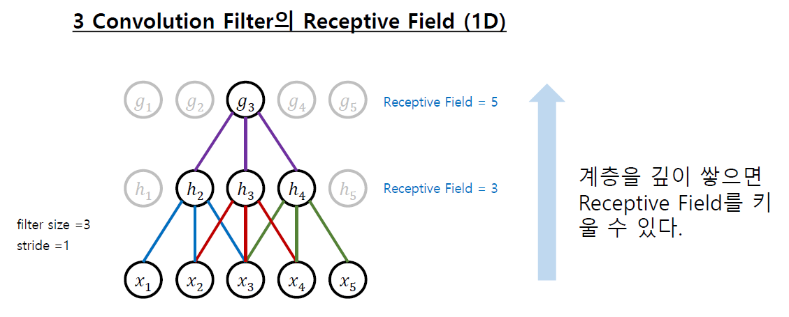
PNP
PASSSION & PIONEER
CNN Architecture
CNN Architecture - VGGNet
“Very Deep Convolutional Networks for Large-Scale Image Recognition”

Slide 42
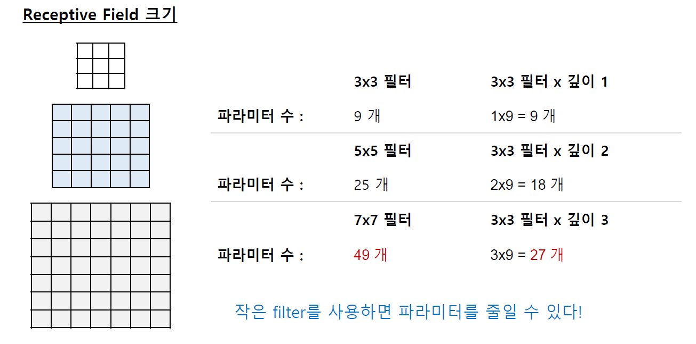
PNP
PASSSION & PIONEER
CNN Architecture
CNN Architecture - VGGNet
“Very Deep Convolutional Networks for Large-Scale Image Recognition”

Slide 43
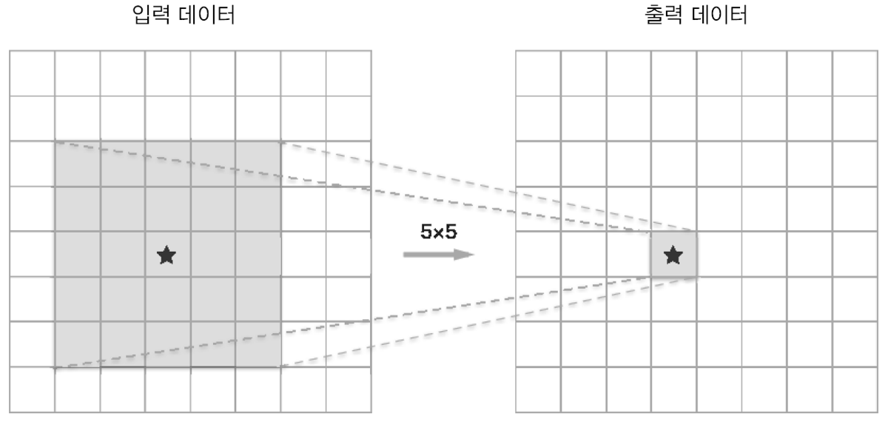
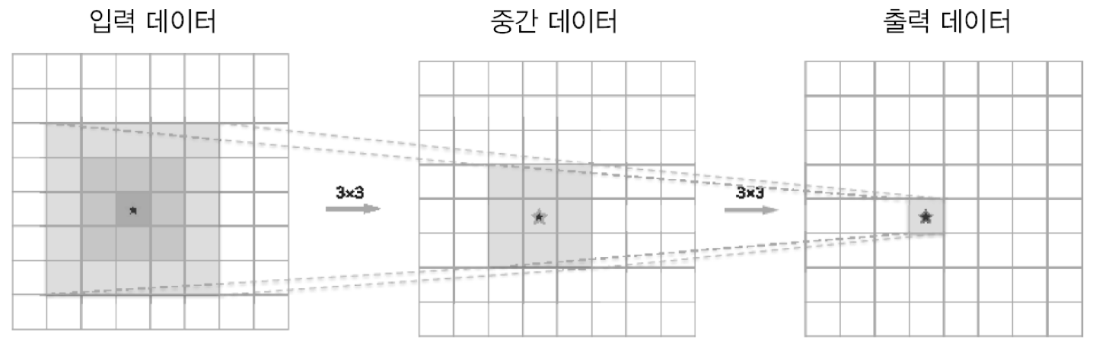
PNP
PASSSION & PIONEER
CNN Architecture
CNN Architecture - VGGNet
5x5 와 (3x3)x2 필터는 같은 영역(Receptive Field)을 처리
층이 깊어져 ReLU 같은 Activation function(비선형성) 추가

Slide 44
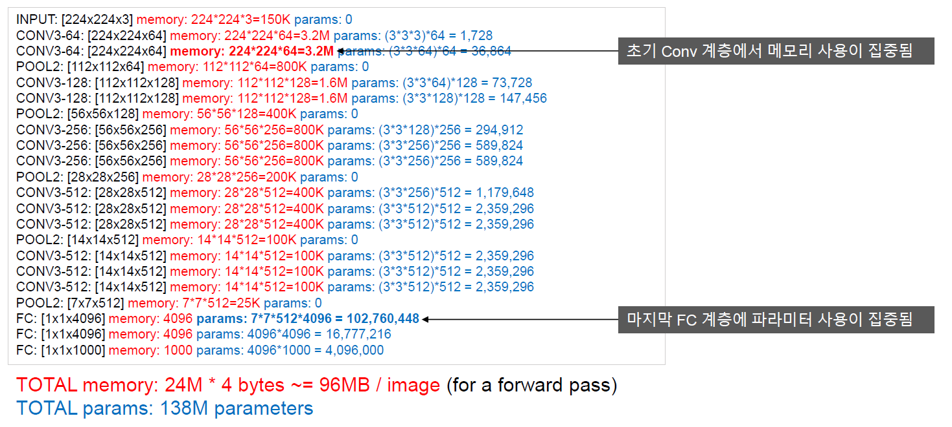
PNP
PASSSION & PIONEER
CNN Architecture
CNN Architecture - VGGNet

Slide 45
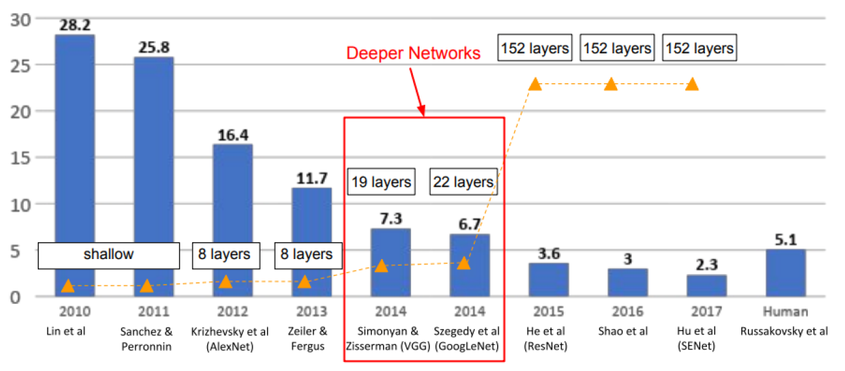
PNP
PASSSION & PIONEER
CNN Architecture
CNN Architecture - GoogLeNet
ImageNet ILSVRC(Large Scale Visual Recognition Challenge) winners

Slide 46


PNP
PASSSION & PIONEER
CNN Architecture
CNN Architecture - GoogLeNet

Slide 47

PNP
PASSSION & PIONEER
CNN Architecture
CNN Architecture - GoogLeNet
“Going Deeper with Convolutions”

Slide 48

PNP
PASSSION & PIONEER
CNN Architecture
CNN Architecture - GoogLeNet
“Going Deeper with Convolutions”

Slide 49

PNP
PASSSION & PIONEER
CNN Architecture
CNN Architecture - GoogLeNet
“Going Deeper with Convolutions”

Slide 50

PNP
PASSSION & PIONEER
CNN Architecture
CNN Architecture - GoogLeNet
“Going Deeper with Convolutions”

Slide 51

PNP
PASSSION & PIONEER
CNN Architecture
CNN Architecture - GoogLeNet
“Going Deeper with Convolutions”

Slide 52

PNP
PASSSION & PIONEER
CNN Architecture
CNN Architecture - GoogLeNet
“Going Deeper with Convolutions”

Slide 53


PNP
PASSSION & PIONEER
CNN Architecture
CNN Architecture - GoogLeNet
“Going Deeper with Convolutions”

Slide 54

PNP
PASSSION & PIONEER
CNN Architecture
CNN Architecture - ResNet
ImageNet ILSVRC(Large Scale Visual Recognition Challenge) winners

Slide 55

PNP
PASSSION & PIONEER
CNN Architecture
CNN Architecture - ResNet
“Deep Residual Learning for Image Recognition”

Slide 56

PNP
PASSSION & PIONEER
CNN Architecture
CNN Architecture - ResNet
“Deep Residual Learning for Image Recognition”

Slide 57

PNP
PASSSION & PIONEER
CNN Architecture
CNN Architecture - ResNet
General Block
Residual Block
중간에 layer를 뛰어넘는 연결을 추가, Skip connection
역전파 시 Gradient가 그대로 소실되지않고 전달된다.
“Deep Residual Learning for Image Recognition”

Slide 58

PNP
PASSSION & PIONEER
CNN Architecture
CNN Architecture - ResNet
“Deep Residual Learning for Image Recognition”

Slide 59

PNP
PASSSION & PIONEER
CNN Architecture
CNN Architecture - ResNet
“Deep Residual Learning for Image Recognition”

Slide 60

PNP
PASSSION & PIONEER
CNN Architecture
CNN Architecture - ResNet
“Deep Residual Learning for Image Recognition”

Slide 61



PNP
PASSSION & PIONEER
CNN Architecture
CNN Architecture - ResNet
“Deep Residual Learning for Image Recognition”

Slide 62
PNP
PASSSION & PIONEER
CNN Architecture
CNN Architecture
“Deep Residual Learning for Image Recognition”

Slide 63
PNP
Q & A ?
밑바닥부터 시작하는 딥러닝 1, 2 http://www.yes24.com/Product/Goods/34970929?Acode=101 http://www.yes24.com/Product/Goods/72173703
모두를 위한 딥러닝 시즌2 https://www.edwith.org/boostcourse-dl-tensorflow/joinLectures/22150

